Slide 1
DA 507 modeling and optimization
Lecture 5
Heuristics
Güvenç Şahin
Birol Yüceoğlu

Slide 2
Data Mining: Clustering Problem
Cluster analysis involves the grouping of data entities in a way that maximizes the homogeneity of entities within a group and, at the same time the heterogeneity of entities between groups.
It is a main task of exploratory data mining, and a common technique for statistical data analysis, used in many fields, including machine learning, pattern recognition, image analysis, information retrieval, and bioinformatics.

Slide 3
Data mining: Applications
Bioinformatics and ecology
spatial and temporal comparisons of communities (assemblages) of organisms in heterogeneous environments
generate artificial phylogenies in plant systematic or clusters of organisms (individuals) at the species, genus or higher level that share a number of attributes
Human genetic clustering
the similarity of genetic data to infer population structures

Slide 4
Data mining: Applications
Market research
partition the general population of consumers into market segments to better understand the relationships between different groups of consumers/potential customers
use in market segmentation, product positioning, new product development and selecting test markets
Grouping of shopping items
group all the shopping items available on the web into a set of unique products (items on eBay can be grouped into unique products / no concept of a SKU)

Slide 5
Data mining: Applications
Social network analysis
to recognize communities within large groups of people.
Image segmentation
divide a digital image into distinct regions for border detection or object recognition
Recommender systems
recommend new items based on a user's tastes
predict a user's preferences based on the preferences of other users in the user's cluster

Slide 6
K-Clustering Problem (Practice)
Your data set consists of 1.000.000 customers
Consider the size of your distance matrix
Consider the number of decision variables
Impossible to solve using integer programming
How can we still solve the problem
  Heuristics

Slide 7
K-Clustering Problem: definition & notation
Each entity i is an element of {1,…,n}
Suppose there are N attributes that describe each entity as a_{ik} (numeric value) corresponding to your features
Define dis-similarity between i and j as the distance such as Euclidean distance
You can use w_{i} as the importance/weight of entity i. We do not consider weights in this example.

Slide 8
K-Clustering Problem: definition & notation
We assign at most k (also called p) cluster centers
Each point is assigned to exactly one cluster center.
A point can only be assigned to a selected cluster center
Objective: Minimize the total distance between each observation and its cluster center

Slide 9
p-Median Problem
In the p-Median problem we are interested in finding the location of p facilities to serve demand nodes so that the transportation cost is minimized.
The transportation cost is given by the product of the demand at the demand node and the distance between the demand node and the facility that serves the demand node.
There are no capacity constraints at the facilities.

Slide 10
p-Median Problem
Remarks
As there are no capacity constraints at the facilities, it is optimal to satisfy the demand at a demand node from a single facility.
An optimal solution can be found by restricting the search to the demand nodes.
Fixed costs are assumed to be equal.
The number of possible solutions is

Slide 11
p-Median Problem
For even moderate values of n and p the number of possible solutions can be very large:
For example, if n=20 and p=5, there are 15,504 solutions.
If n=50 and p=10, the problem has more than 10¹⁰ possible solutions.
If you could evaluate 1 million solutions per second, it will take you 3 hours for total enumeration.

Slide 12

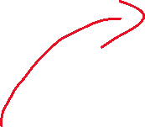

p-median Example
A, D, E are cluster centers
A, B is assigned to A
C, D is assigned to D
E, F are assigned to E
Total distance: 26
10
A
D
8
7
12
9
C
F
13
13
9
7
B
E
17

Slide 13
The p-Median Problem
In the p-median problem we are interested in finding the location of p facilities to serve demand nodes so that the transportation cost is minimized.
The transportation cost is given by the product of the demand at the demand node and the distance between the demand node and the facility that serves the demand node.
There are no capacity constraints at the facilities.

Slide 14
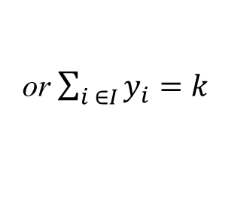
The (K-Median) p-Median Problem
Minimize
Subject to
or $\sum_{i ∈I}{y_{i}=k}$

Slide 15
The p-Median Problem
General Assumption:
  1. Network type customer and facilities
  2. Candidate facilities are located on the customer nodes, given a network of customers connected to each other.
Even if not so, …
  Property: At least one optimal solution consists of locating the p facilities on the customer nodes of the network.

Slide 16
The p-Median Problem
Number of alternative solutions:
  fixed p ➔polynomial in N ➔should be solvable???
  variable p ➔ O(2^{N}) ➔too much computational effort!!!
The problem is NP-Complete in general.
WE NEED TO DEVELOP/USE HEURISTIC METHODS!!!

Slide 17
P-Median: Heuristic algorithms
Construction algorithms
  A myopic algorithm
Improvement algorithms
  A neighborhood search algorithm
  An exchange algorithm
Two fundamental goals in computer science are finding algorithms with provably good run times and with provably good or optimal solution quality. A heuristic is an algorithm that gives up one or both of these goals; for example, it usually finds pretty good solutions, but there is no proof that solutions could not get arbitrarily bad; or it usually runs reasonably quickly, but there is no argument that this will always be the case.

Slide 18
p-centers Problem
We assign at most p cluster centers
Each point is assigned to exactly one cluster center.
A point can only be assigned to a selected cluster center
Objective: Minimize the maximum distance between each observation and its cluster center

Slide 19
p-center Example
A, D, E are cluster centers
A, B is assigned to A
C, D is assigned to D
E, F are assigned to E
Max. distance: 9
10
A
D
8
7
12
9
C
F
13
13
9
7
B
E
17

Slide 20
K-Clustering: K-center Example
10
A
D
8
7
12
9
C
F
13
13
9
7
B
E
17

Slide 21
K-Means Algorithm
Start with a random set of cluster centers
Assign every customer to the closest cluster center
Update the cluster centers based on your assignment
Repeat this step until
  A certain number of iterations
  Changes are small or non-existent
Not necessarily optimal

Slide 22
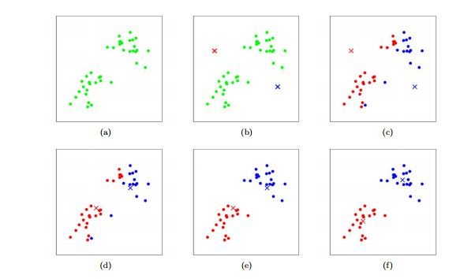
K-Means Algorithm

Slide 23
Heuristics
A heuristic is any approach to problem solving or self-discovery that employs a practical method that is not guaranteed to be optimal, perfect or rational, but which is nevertheless sufficient for reaching an immediate, short-term goal.
Heuristic methods can be used to speed up the process of finding a satisfactory solution and can help your exact procedures by providing empirically good bounds.

Slide 24
P-Median: A myopic algorithm
If we were to locate only a single facility,
  how would you choose?
  how would you allocate?
If you know p-1 facilities already,
  how would you choose the last one?

Slide 25
P-Median: A myopic algorithm
Step 1: Initialize k=0 and X_{k}={}.
Step 2: k=k+1
Step 3: Compute Z^{k}_{i}=∑_{j} d_{j} c(i U X_{k-1}, j) for all facilities not in X_{k-1}.
Step 4: Find i*_{k}=argmin_{i} {Z^{k}_{i}}, and set X_{k-1}=X_{k-1} U {i*_{k}}.
Step 5: If k=P, stop; the set X_{p} is a solution. Otherwise, go to Step 2.

Slide 26
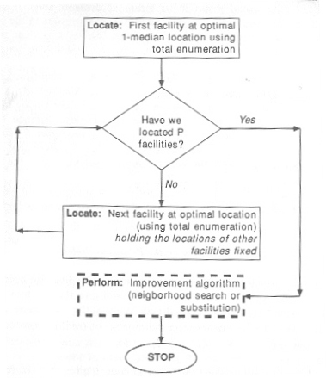

Slide 27
p-Median Problem
15
10
12
18
15
22
18
A
B
C
D
24
16
12
20
18
E
5
25
24
F
24
12
12
15
30
G
H
I
11
13
22
16
19
22
25
19
J
K
L
19
21
22
19
20

Slide 28
p-Median Problem
Distance matrix for the network

Slide 29
p-Median Problem
Cost (demand x distance) matrix for the network
h_{i} x d_{ij}

Slide 30
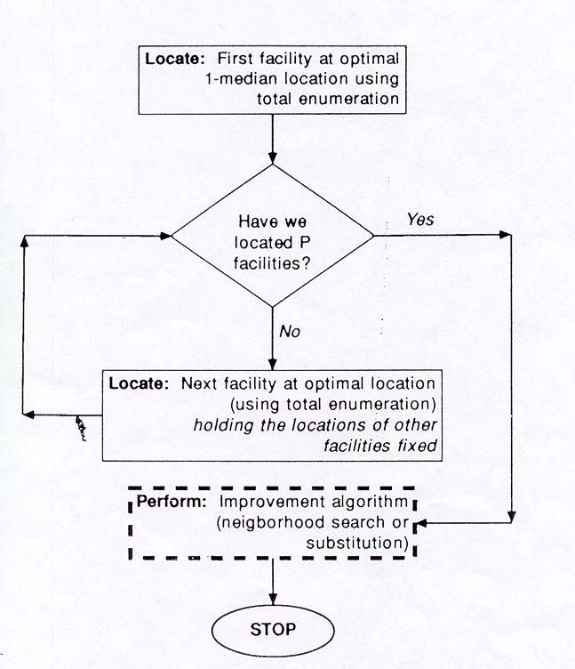
p-Median Problem
Heuristic Algorithm

Slide 31
p-Median Problem
serving all the demand from a facility at A

Slide 32
I’nın açık olduğunu bildiğimizde A’ya açma durumunda maliyet sorusu
p-Median Problem
If we locate only one facility, it should be at site I with a total cost of 4772.
What if we want to open a second facility?
A B ... I
A 0 225 720
B 150 0 420
C 444 264 240
D 990 720 432
E 120 190 120
F 1440 1248 288
G 198 363 495
H 528 768 480
I 624 546 0
J 880 1210 836
K 1102 1159 361
L 1340 1230 380
A B
A 0 225
B 150 0
C 240 240
D 432 432
E 120 120
F 288 288
G 198 363
H 480 480
I 0 0
J 836 836
K 361 361
L 380 380

Slide 33
p-Median Problem
It is best to open the second facility at site G.

Slide 34
p-Median Problem
Results for first five locations (medians)
Location Number Site Total cost
1 I 4772
2 G 3145
3 F 2641
4 J 2157
5 A 1707
Now, given the location of five facilities, each demand node should be assigned to the nearest facility.

Slide 35
p-Median Problem
Assign nodes A, B, E* to facility A
D, F F
G, H G
C, I, K*, L I
J J

Slide 36
15
10
12
18
15
22
18
A
B
C
D
16
24
5
12
20
18
E
25
24
F
24
12
15
30
12
G
H
I
11
13
22
16
19
22
25
19
J
K
L
19
21
22
19
20

Slide 37
p-Median Problem
Note that the optimal solution had a total cost of 1444 whereas the heuristic solution provides a total cost of 1707.
This means that we can improve the solution obtained by the heuristic. Therefore we apply an improvement algorithm.
For each facility site, this algorithm identifies the set of demand nodes that are served from the facility called as the neighborhood.
Within each neighborhood, the optimal 1-median is found.

Slide 38
Improvement: Neighborhood Search
Start with a feasible solution
For each allocation neighborhood
  Find the optimal 1-median
Reallocate globally
Repeat until
  no neighborhood 1-median changes, or
  no neighborhood changes (???)

Slide 39
15
10
When we remove the cluster center from G to H we have two sources of profit:
Assigning the demand of H to G costs 16*15 = 240
Assigning the demand of G to H costs 11 * 15 = 165 (profit 75$)
We can assign E to H (instead of A) to reduce the cost further (5*24 – 5 *12 = 60$ profit)
The objective function value decreases by 135$ to 1572$.
15
A
B
24
5
18
E
25
12
G
15
H
11
16

Slide 40
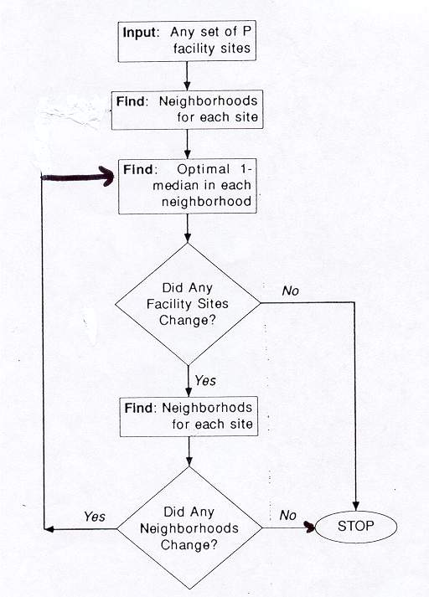
p-Median Problem (Improvement)

Slide 41
15
10
12
18
15
22
18
A
B
C
D
24
16
12
20
18
5
E
25
24
F
24
12
15
30
12
G
H
I
11
13
22
16
19
22
25
19
change=-135
J
K
L
19
21
22
19
20

Slide 42
p-Median Problem (Improvement)
Summary of Exchange Opportunities from Neighborhood Search Solution (Facilities at sites A, F, H, I and J with a total cost of 1572)
Remove Replace Total Change
With Cost
A B 1647 75
F D 1620 48
H E 1689 117
I L 1444 -128
J K 1629 57

Slide 43
15
10
12
18
15
22
18
A*
B
C
D
24
16
12
20
18
5
E
25
F*
24
24
12
15
30
12
G
H*
I
11
13
22
16
19
22
25
19
J*
K
L*
19
21
22
19
20

Slide 44
p-Median Problem (Improvement)
Summary of Exchange Opportunities from Improved Solution (Facilities at sites A, F, H, J and L with a total cost of 1444)
Remove Replace Total Change
With Cost
A B 1447 3
F D 1487 43
H E 1465 21
J K 1501 57
L K 1503 59

Slide 45
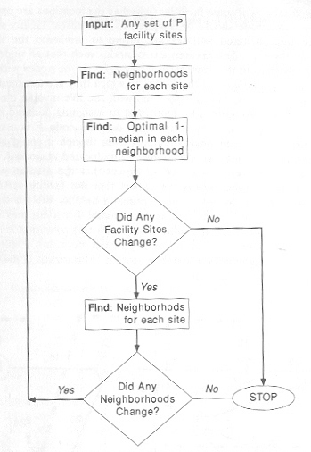

Slide 46
Improvement: Exchange Facilities
Start with a feasible solution
For each open facility in the solution
  For each closed facility in the solution
    Replace it with one of the closed
    Calculate improvement
  Find best improvement if there is any
  Replace the open facility with the closed one

Slide 47
Near-optimal? Sub-optimal?
Is it always all wrong/unwanted to be only near-optimal instead of optimal?

